Slide 1
Estimation
Most projects overshoot their estimated schedules by 25 - 100 %
Accurate estimates are foundation of rapid development
Following slides discuss some of the how’s in estimation
Notes:
Chapter 8 in text plus material from Caper Jones Software Productivity Research
Highly recommend reading chapter eight

Slide 2
SPR Analysis
Historical software projects, medium to large (2,000 to 20,000 function points) show:
  programming took 20% to 50% longer to develop than initially estimated
  development costs were 50% to 150% higher than initially estimated
  defect rates were up to 1,000% higher than initially estimated
  maintenance costs were up to 1,000% higher than initially estimated

Slide 3
Observations on
Large Systems
Number of lines of code at delivery was 44% larger than initial estimate
  primarily requirements creep
35% more function points at delivery than initial estimate
Projects moved form site to site had larger errors than single-site projects
Multi-site projects had larger errors than single-site projects

Slide 4
Measurement and Estimation
To estimate with ±10% accuracy, historical data must be accurate to within ±5%
Most companies’ historical data is incomplete and misses 30% to 75% of actual costs and effort
Most companies’ estimates are wrong by 50% to 150%

Slide 5
Hazards to Avoid in Estimating
Estimating only a subset of activities
Underestimating the size and complexity of the system
Overestimating staff skills
Overestimating the (positive) impact of new tools and techniques
Underestimating the learning curve
Trading quality and completeness for schedule

Slide 6
Development as Refinement
When can you know estimates to within 10 percent?
What uncertainties can impact the estimates?
Notes:
From text:
Will customer want feature X?
the cheap or expensive version of X (factor of 10)?
After implementing the cheap version, will customer want the more expensive version?
How will feature X be designed? (factor of 10 design complexity)
What is quality level of feature X? (factor of 10 in defect density)
How long to debug and correct? (factor of 10 from individual to individual)
How log to integrate X?
Leads to uncertainties in next slide...

Slide 7
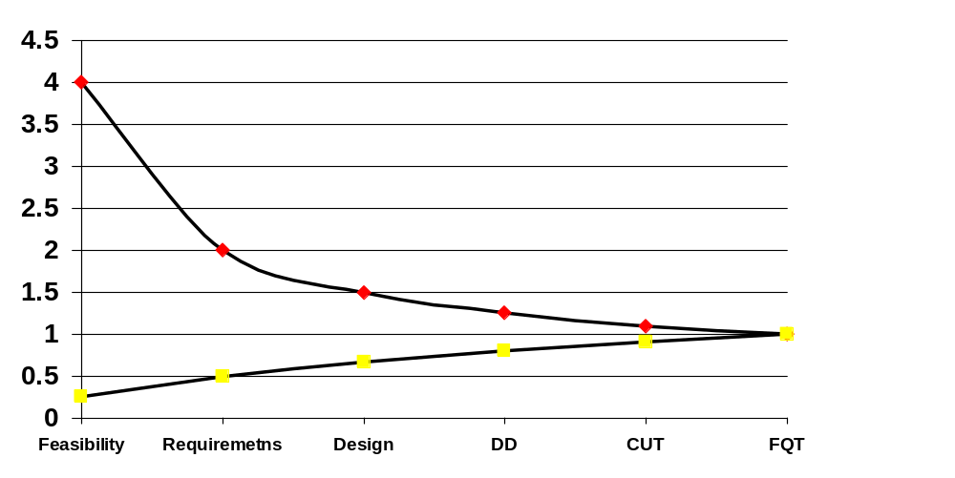
Estimation Accuracy
Versus Phase

Slide 8
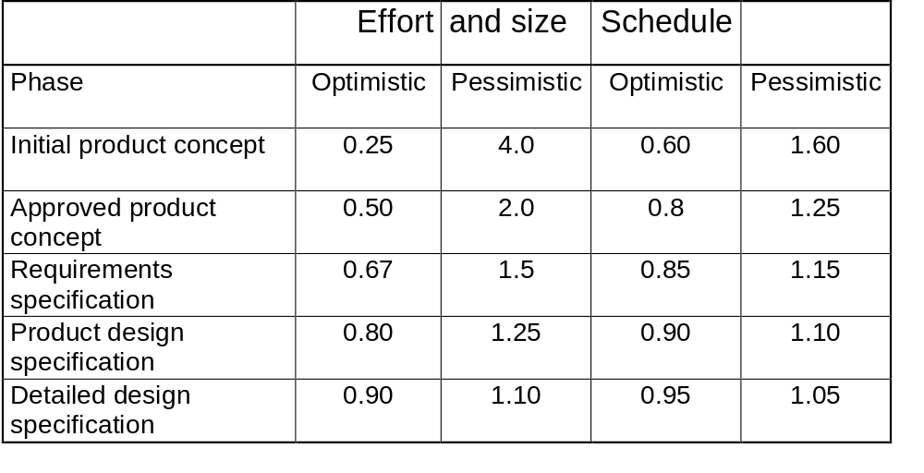
Uncertainty by Phase
Notes:
Assumes schedule is estimated from effort. If estimate schedule independently, then effort uncertainties apply.
If you have control, you can go by the lower curves:
If you can be flexible about product characteristics you can build to budget, by leaving things out, and choosing the implementation that costs less.
If you do not consistently choose the cheaper path, you are not building to budget, but doing normal development, and will have uncertain estimates.
Shortest schedule results in best estimate (no rush at end to catch up, or work filling the time available).
Based on above, estimates should be refined as project goes along.

Slide 9
Estimation Process Overview
Estimate the size of the project (lines of code or function points)
Estimate the effort (man-months)
Estimate the schedule (calendar months)
Provide estimates in ranges and refine the ranges as project progresses
Notes:
COCOMO and similar models can be used for the intermediate steps

Slide 10
Common
Size Estimation Techniques
Algorithmic models (function points)
Expert judgment
Analogy
Price-to-win (not really an estimate)
Bottom-up
Delphi model with experts

Slide 11
Function Point Analysis
Due to A. J. Albrecht of IBM
Attempts to measure size of software without counting lines of code
Function points can be counted from requirements descriptions

Slide 12
Function Points (Simplified)
Evaluate the weighted sum:
  Number of inputs, times 4
  Number of outputs, times 5
  Number of inquires, times 4
  Number of master files, times 10
  Number of interfaces, times 7
The result is the number of function points for the application
Notes:
See example in text, page 176, 177
These coefficients assume medium complexity
The slides in 7081 included the complexity differences, as well as the influence multiplier.
This slide is to remind them.

Slide 13
Relationship of LOC to FP
Approximate number of lines of code for one function point are:
  Language LOC/FP
  Assembly 300
  C 128
  COBOL 100
  Pascal 90
  C++ 53
  Java 53
  Ada 95 49
  Visual Basic 5 29
  Object-Oriented Languages 30
  Fourth Generation Languages 20
  Automatic Code Generators 15

Slide 14
Estimation Tips
Avoid off-the-cuff estimates
Allow time for the estimate
Use data from previous projects
Use estimates from the developers
Get as much detail as possible
Use software estimation tools
Use different techniques for comparison
Reestimate as project goes along

Slide 15
Ballpark Schedule Estimates
Tables 8-8 through 8-10 in text give ballpark estimates of schedule and effort
  as a function of size in LOC
  for systems products, business products and shrink-wrapped products
  for shortest possible, efficient, and nominal schedules
Compare these with your project results
Notes:
Systems software does not include firmware, real-time embedded, avionics, process control which would be lower.
For function points use the conversion table earlier.
Cost is proportional to LOC not FP.

Slide 16
Facts of Life
There is a shortest possible schedule, and you can’t beat it
Costs increase rapidly when you shorten the schedule below nominal
Most projects should use the nominal schedules

Slide 17
Estimate Refinement
The greatest unknowns in estimates are caused by the uncertainty in the software’s definition
  developing the project is required to refine this
Provide ranges and reestimate as you go along

Slide 18
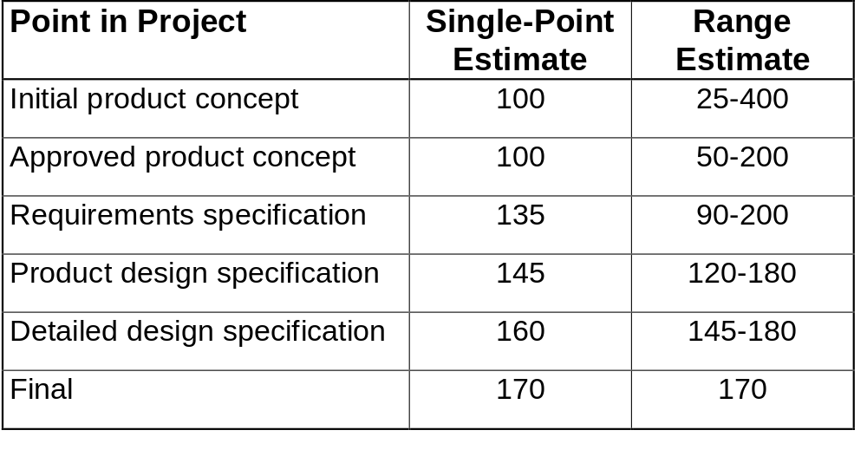
Example of Estimates
Notes:
How would these two histories be perceived?
The second shows great ranges, but is more honest.

Slide 19
Recalibration
What when you miss a milestone?
Say you take 5 weeks instead of 4
Should you:
  assume you can make up the lost week later?
  add the week to the total schedule?
  multiply the schedule by the amount of the slip - 25%?
Avoid the problem by using ranges as above
  see case study 8-2
Notes:
Projects hardly ever make up lost time
Unlikely that this phase is the only one in error
This leaves option 3 as most correct in almost all cases.
Alternates are to change the product (reduce functionality or quality) or cost (add more people) - recall schedule/product/cost triangle.

Slide 20
Schedule Pressures
“Excessive or irrational schedules are probably the single most destructive factor in all of software” - Capers Jones
How do overly optimistic schedules happen?
Can you think of any ways to improve this?
Notes:
This is largely from chapter 9 in text.
Another highly recommended chapter

Slide 21
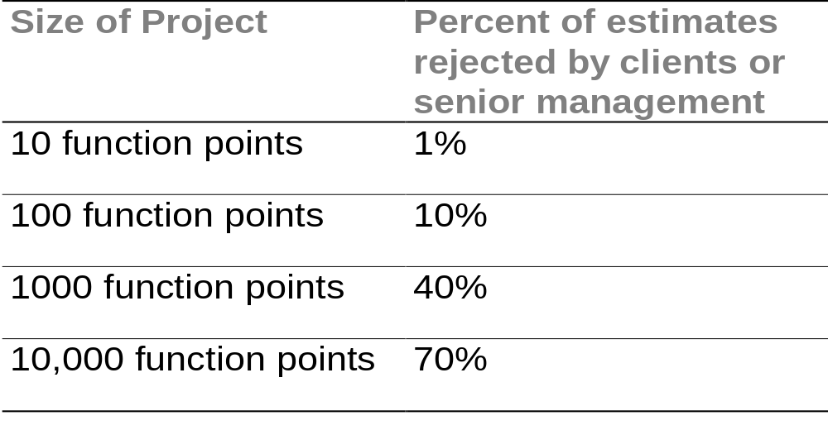
Estimation and Politics
Accurate estimates are seldom believed
Notes:
After you have a good estimate, you have to sell it!

Slide 22
Example of Optimistic Scheduling
Example in book on WinWord 1.0 schedule
  original estimate 365 days
  actual development 1887 days
Based on unachievable goals
  develop best word processor ever
  as fast as possible, preferably 12 months
Aggressive schedule resulted in poor planning, high turnover, poor quality, slow development (poorer than nominal!)

Slide 23
Root Causes of
Overly Optimistic Schedules
External, immovable deadline
Managers plan based on best case estimate
Underestimated to submit a winning bid
Underestimated to get funding
Management believes developers will work harder with ambitious schedule
Feature creep
Just poor estimates
Notes:
Can you exhort software developers to work faster?
It doesn’t work with software - see effects on next slide.

Slide 24
Effects of
Overly Optimistic Schedules
Poor schedule accuracy
Plans based on bad assumptions
Plan gets thrown out when project gets into schedule trouble
Project rushes requirements and design
Management focus on damage control
Customer and company relations sag
Premature convergence
Notes:
Normal schedule estimates often 20-30% low, if overly optimistic then even lower.
Average small project estimate off by >100%.
projects have to explain to company and customer what is happening and spends excess time replanning.
Convergence - starting end tasks too soon, e.g. performance tuning, removing partially implemented features, implementing quick & dirty features that must ship, polishing help files and user documents, doing end-to-end tests.
Next result is Excessive schedule pressure - see next

Slide 25
Excessive Schedule Pressure
Quality plummets
Excessive risk taking
Motivation drops
Creativity reduced
Burnout
Turnover
Notes:
Get this when you don’t meet the optimistic schedule

Slide 26
Bottom Line
Overly optimistic scheduling doesn’t work
Results in un-rapid development

Slide 27
Beating Schedule Pressure
Break the vicious circle
More
schedule
pressure
Ignorance of
software
estimation
Wishful
thinking
More
schedule
slips
More
stress
Poor
negotiating
skills
Ignorance of
overly optimistic
scheduling effects
More
mistakes
Notes:
Need to eliminate the causes,
Have already talked about all but negotiating skills.
Why poor negotiating skills?
Most developers introverts
schedules set in negotiations between developers and management or marketing people who are more experienced negotiators
Developers think negotiating tricks are unfair or dishonest
Developers have a hard time defending a schedule which is derived from no quantitative method, supported by little data and certified primarily by hunches.
Developing negotiation skills critical.

Slide 28
Principled Negotiation
Described in Getting to Yes (Fisher and Ury, 2nd Ed., 1991)
Doesn’t rely on tricks
Explains how to respond to tricks
Based on creating win-win options
Works when other side has also read the book
Other good source: Gerard Nierenberg http://www.negotiation.com/
Notes:
Nierenberg wrote The Art of Negotiation, Creative Business Negotiating, Fundamentals of Negotiating, How to Read a Person Like a Book, etc.
His web site offers seminars on negotiation, cost around

Slide 29
Four Part Strategy
Separate the people from the problem
Focus on interests, not positions
Invent options for mutual gain
Insist on using objective criteria
See http://www.pon.harvard.edu/
Notes:
Harvard Negotiation Project workshop around US$ 1000

Slide 30
Separate the People
From the Problem
Negotiators are people first
  deal directly with the people problems
  do not solve people problems with concessions
The people relationship gets entangled with the problem
  try to consciously separate it
Correct errors in perception
Acknowledge emotions and deal with them
Communicate with active listening
Notes:
People have emotions, deeply held values, different backgrounds and viewpoints and are unpredictable - so are you.
Pay attention to the people side of the problem
Emotions are telling you something - listen.
Allow other side to let off steam
Don’t react to emotional outbursts
Lots of other things could be said here

Slide 31
Focus on Interests,
Not Positions
Invoke other interests beyond just schedule
  true development speed requires realistic schedule
  realistic schedule increases success probability
  low cost conflicts with overly short schedule
  high quality conflicts with overly short schedule
Find shared and compatible interests
  go to reasons behind the positions - ask “Why?”
Realize each side has multiple interests

Slide 32
Invent Options for
Mutual Gain
Use technical ability to generate options
  move functionality into version 2
  deliver product in stages
  cut features
  less polish
  add developers (only if early in schedule), specialists
  add inspectors, testers
  reduce red tape
  add customer project champion
Notes:
See text for other suggestions pp. 225, 226
In brainstorming mode, don’t make hard commitments to new options until you have had enough time to analyze them.

Slide 33
Insist on Objective Criteria
Common customer ploy is to ignore estimate
  don’t yield to pressure, just to principle
Negotiate inputs to the estimate, not the estimate itself
  size, cost drivers
Insist on a rational estimation procedure
  fix features first, then derive cost/schedule
  accept that estimates have reasonable error
Stand firm, weather the storm

Slide 34
Conclusions
Choose the right lifecycle for the project and customer
  no single right answer for all questions
Estimate the effort and schedule from the size and cost factors
Resist schedule pressure
Negotiation is a useful life skill to aquire

